Slide 1
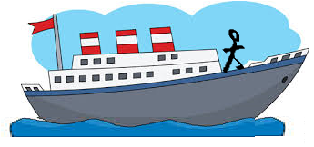
Relative Velocity Warm up!
A river cruise Passenger is walking at 5.0 km/h backwards relative to the ship deck. The Ship is travelling at 8.0 km/h [North] relative to the river water. The River is flowing at 4.0 km/h [North] relative to the ground.
Write a chain rule statement for the passenger’s velocity relative to ground and solve for the velocity.
Ans: P-Passenger, S- Ship, R-River, G-Ground
V_{PG}=V_{PS} + V_{SR} +V_{RG} Let N = +
=-5.0 + 8.0 + 4.0= +7.0 = 7.0 km/hr [North]

